Slide 1
Access to Online Educational Resources
Prof. Dr. Zahid Hussain
Professor & Dean Faculty of Science, QUEST, Nawabshah
zhussain@quest.edu.pk

Slide 2
Top 5 Universities of the World????????

Slide 3
Facebook??

Slide 4
edX: Access to free education for everyone
https://www.edx.org/
Founded by Harvard University and MIT (Massachusetts Institute of Technology) in 2012, edX is an online learning destination, offering high-quality courses from the world’s best universities and institutions to learners everywhere. One can enrol in any course by creating an account on the website.

Slide 6
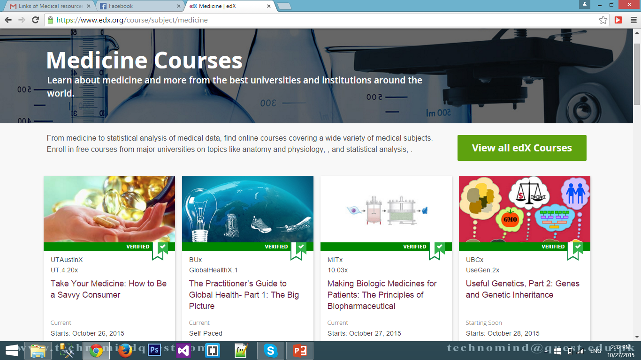

Slide 7
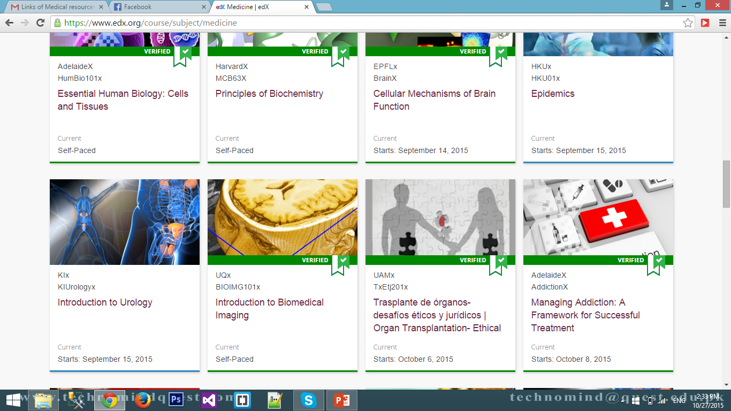

Slide 8
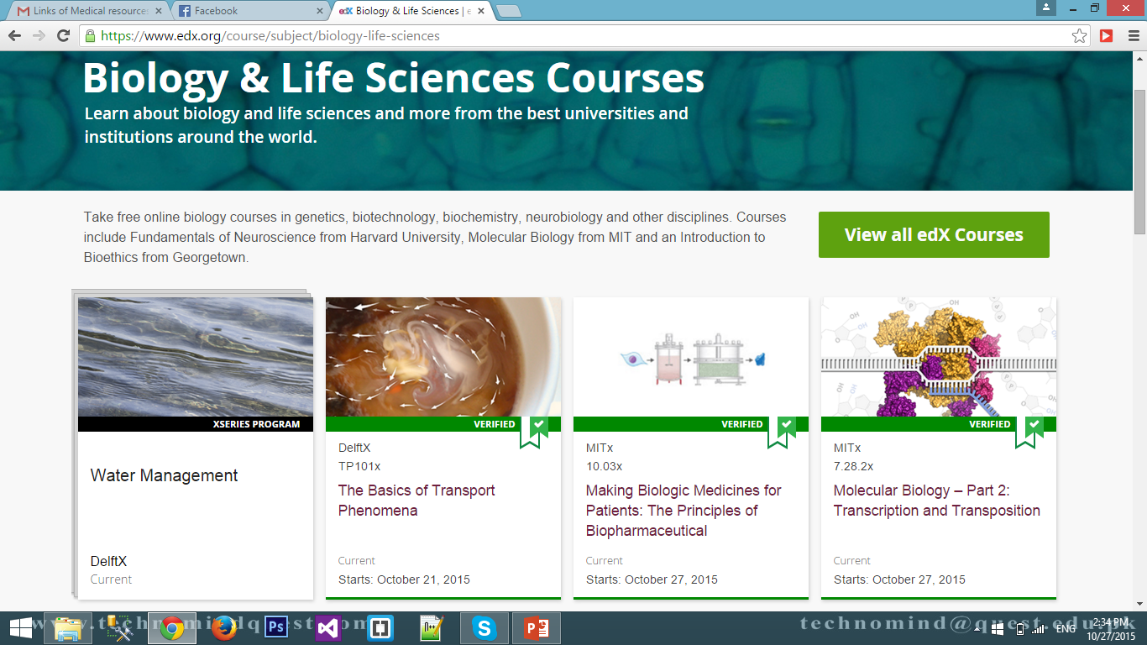

Slide 9
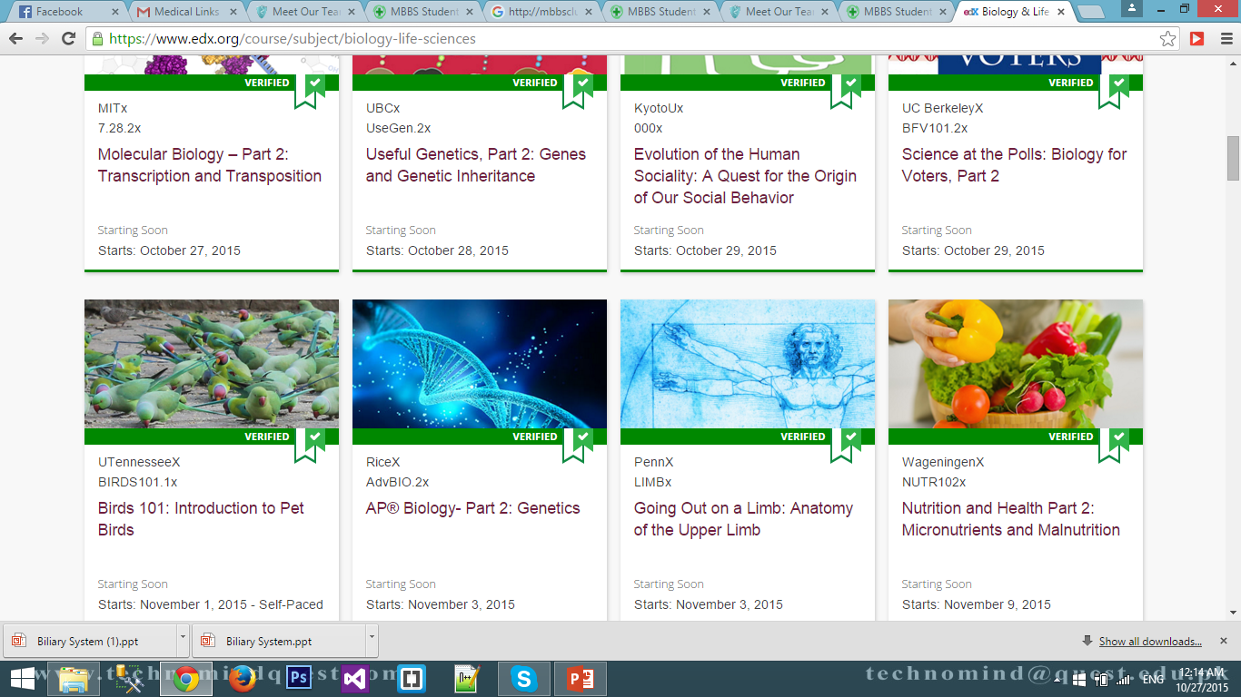

Slide 10
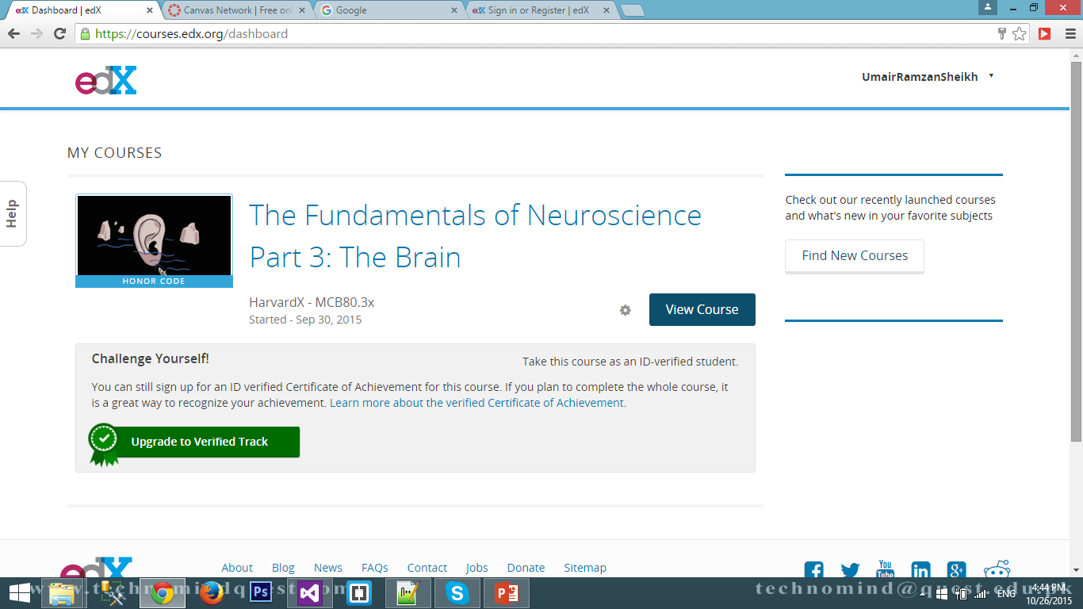
After Registration

Slide 11
Coursera
https://www.coursera.org/
Coursera’s aim is to offer people great online education so that anyone around the world can learn without limits. This website partners with more than 80 top global universities and organisations such as Yale, Princeton, Johns Hopkins, The World Bank and Stanford University, to offer online courses for anyone to take for free or with nominal fees. Coursera students can watch lectures taught by world-class professors, learn at their own pace, test their knowledge, and reinforce concepts through interactive exercises. Courses are offered in the fields of Humanities, Medicine, Biology, Social Sciences, Mathematics, Business, Computer Science and many others.

Slide 17
Canvas
https://www.canvas.net/
Canvas Network offers open, online courses taught by educators everywhere. It provides a place and platform where teachers, students, and institutions worldwide can connect and chart their own course for personal growth, professional development, and academic inquiry. One can enrol in any course by creating account on the website.

Slide 20
MBBS Study Stuff
http://www.mbbsstudystuff.wordpress.com/
This blog is designed with the aim of helping medical students & sharing everything they need to go through med school easily. This blog contains year wise course lectures, syllabus, paper patterns, MCQs, past papers, video lectures, useful website links, etc. The founder and administrator of this blog is Umair Ahmad, final year MBBS student from Shaikh Zayed Medical College and Hospital, Rahim Yar Khan.

Slide 22
MBBS Club
http://mbbsclub.com/
This site is built to spread medical knowledge especially among medical students. This is a place where medical students will be able to get lectures slides. Knowledge based blog posts are also published from time to time to highlight upcoming challenges regarding health and medicine; and to guide and educate the medical students as well as general public to the latest tips in the domain of health and medicine.

Slide 24
Khan Academy
https://www.khanacademy.org
In 2004, Salman Khan (no, not the actor) began giving his cousin Nadia and her brothers math lessons via telephone, YouTube and Yahoo Doodle. This is how Khan Academy was created. Armed with the motto “free world-class education for anyone anywhere”, Khan Academy is a non-profit organisation offering tutorials in mathematics, finance, history and science topics such as biology, chemistry and physics.
For each course taken students can see their stats to monitor their progress and earn badges and points for learning.

Slide 29
Learnerstv.com
This is a comprehensive site providing thousands of downloadable Video lectures, Live Online Tests, etc. in the fields of Biology, Physics, Chemistry, Mathematics, Computer Science, Engineering, Medicine, Management and Accounting, Dentistry, Nursing, Psychology, History, Language Training, Literature, Law, Economics, Philosophy, Astronomy, Political Science, etc. FREE to its visitors...

Slide 30
Learnerstv.com
This site provides free video and audio lectures of whole courses conducted by faculty from reputed universities around the world. Science Animations provide students with fun and innovative ways of learning. Free live timed online tests with instant feedback and explanations will help you refine your test taking skills. Most of the materials offered are licensed by the respective institutes under a Creative Commons License.

Slide 32
TED Talks
https://www.ted.com/talks
If you have never logged on to TED, you are missing out on something special.
The website gets its name from Technology, Entertainment, Design and brings together the world’s most fascinating thinkers and speakers to give inspirational talks in 18 minutes or less.
These lectures may not be like formal classroom lectures given by professors but can be life-changing because they may alter the way you think and perceive the world around you.

Slide 33
TED Talks
The lectures can be funny, thought-provoking, educational or just fascinating and cover the fields of technology, entertainment, business, science, global issues, etc.
Speakers delivering talks on TED cross all barriers of race, culture, gender and nationality and can give students important lessons on how to hold your audience spellbound with your knowledge, wit and words.

Slide 36
99U.com
Do you want to make your dreams a reality? In absence of career counseling and dedicated mentors in Pakistan, students often lack proper guidance when it comes to facing the practical world outside the classroom and here 99U.com can be of great help. Though not strictly for students, this website is highly recommended for its excellent articles and videos on career development, decision-making, office dynamics, leadership, time management, interview tips and public speaking.

Slide 37
OpenCourseWare
http://ocw.mit.edu/index.htm
MIT’s OCW offers free digital publication of high quality college and university-level educational materials.
These materials are organised as courses, and include course planning materials, thematic content and evaluation tools. Accessible to anyone, anytime via the internet, OCW material is free and promises a world in which the desire to learn is fully met by the opportunity to do so.

Slide 38
Udacity.com
This website makes high-quality education affordable and accessible for all students across the globe and offers free courses in fields of Business, Computer Science, Design, Mathematics and Science.
Students signing up with Udacity.com can update their skills by learning about modern technologies and latest innovations with the most up-to-date curriculum.

Slide 39
Learnstreet.com
This relatively new website provides online education for computer programmers by offering beginner level courses for Ruby, Python and JavaScript. Its aim is to enhance professional skills in students needed for employment in the software industry. By accessing interactive, bite-sized lessons, video tutorials and student question-and-answer resources, users can learn and practice their programming skills with a library of Code Garage Projects.

Slide 40
NovoEd.com
Another website worth checking out is NovoEd where students can take courses from distinguished professors from top educational institutes. By signing up for a NovoEd course, students can collaborate with fellow students from around the world and work on real-world course projects and assignments.
The courses are free but students have to finish assignments by given deadlines to achieve the statement of accomplishment from the instructors.

Slide 41
PTCL Click 2 Learn
http://click2learn.pk
PTCL Click 2 Learn
Covers All Groups of Matric & Intermediate and offers preparatory resources for entry tests of all leading universities in Pakistan.

Slide 42
elearn.punjab.gov.pk
eLearn.Punjab is an important component in Punjab's education roadmap. For the first time in Pakistan, they are making the textbooks freely available online from class VI to X, augmented with a lot of supplementary material. They have made this platform to also crowdsource content from their users, which will make textbooks richer and enhance the overall learning experience.

Slide 43
turtlediary.com
Pre KG to Class V
Maths, English, Science, History
Lessons in the form of games
Solar system video in class I

Slide 44
MS / PhD within Pakistan
Free for students of interior Sindh within Pakistan
NTS/Local GRE required (GRE General for MS and GRE Subject for PhD)
Free Laptops
www.hec.gov.pk
HEC Indigenous Scholarship
Universities own scholarships
Brain Drain??

Slide 45
MS / PhD Abroad
For foreign: just Google it ☺
www.oaed.at for Austria
https://www.daad.org/ for Germany
https://studyinsweden.se/ for Sweden
http://www.usefpakistan.org/ USA Fulbright Scholarship
http://en.csc.edu.cn/ and http://laihua.csc.edu.cn or http://www.csc.edu.cn/studyinchina/scholarshipen.aspx
For Chinese Government Scholarships
Foreign Universities also annouce scholarships on their own websites
Good Research Proposal + Acceptance letter from Foreign Professor/Supervisor

Slide 46
Research Proposal / Dissertation
How to write a research proposal http://www.youtube.com/watch?v=viZk6gMaGAM&feature=related
How to write a dissertation http://www.youtube.com/watch?v=FW9fxl9XX0M

Slide 47
For Intermediate Students
Prime Minsiter‘s National ICT Scholarship Program .................
www.ictrdf.org.pk
IBA Sukkur
www.iba-suk.edu.pk
IBA Karachi: Sindh Foundation Program
http://sfp.iba.edu.pk/

Slide 48
Tips
IELTS (International English Language Testing System, Jointly administered by the British Council, University of Cambridge, UK)
TOEFL (Test Of English as a Foreign Language, administered by US-based organization the Education Testing Service)
GRE (Graduate Record Examination)
Books (your personal library)
English (Communication skills+Confidence)
General Knowledge
Current Affairs
dawn.com
CV (Curriculum Vitae)/Resume
Just Google it

Slide 49
USMLE (United States Medical Licensing Examination)
GMAT (Graduate Management Admission Test)
ECAT (Engineering College Admission Test)
MCAT (Medical College Admission Test)
SAT (Scholastic Aptitude/Assesment Test)

Slide 50
Cooking
☺

Slide 51
Thanks
☺

